Slide 1
Sizewell C update 2023
Aldeburgh Parish Council Meeting
Thursday 9th November 2023
Richard Knight – Senior Community Relations Manager
Zoe Botten – Community Relations Manager

Slide 2

Agenda
Meet the READ Team
Deed of Obligation/ Pledges
Working Groups and Forums
Accommodation and Housing
Occupational Services, Emergency Services, Worker Code of Conduct
Community Fund
Economy and Tourism
Transport / Associated Developments
Works Tracker

Slide 3
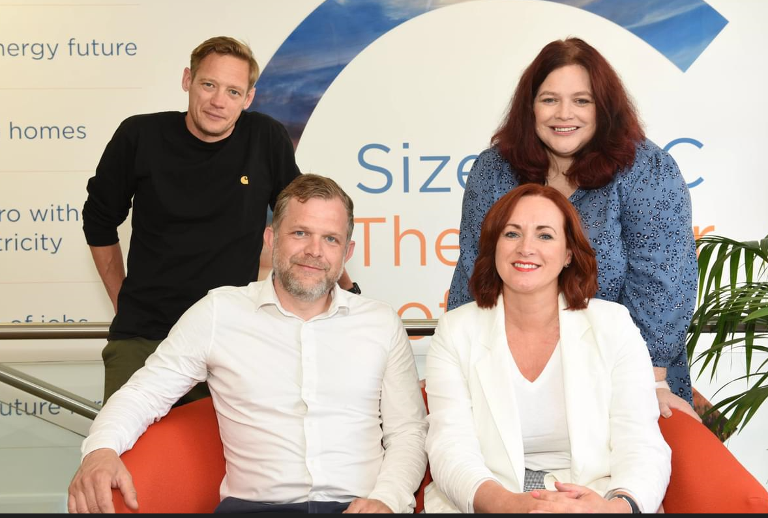
Community Relations Team
Paul Lennon – Michelle Emmerson Grey
Senior Community Relations Manager for Residents and
Land. Paul’s team is responsible for engaging with residents
and landowners regarding the project, addressing enquiries
and/or any concerns they have.
Richard Knight – Zoe Botten
Senior Community Relations Manager for
community governance and will engage with Parish
Councils and local authorities regarding project updates and the
future governance of the Deed of Obligation.

Slide 4
Effective Relationships
Accountability
Honesty
Listening
Open Communication
Trust
Mutual Respect

Slide 5
Deed of Obligation
Resourcing of local authorities
Accommodation and Housing
Emergency Services
Health and Wellbeing
Public Services and Community Safety
Natural Environment
Employment and skills
Tourism
Noise
Heritage
Transport
Community Fund
Leisure and Amenity

Slide 6
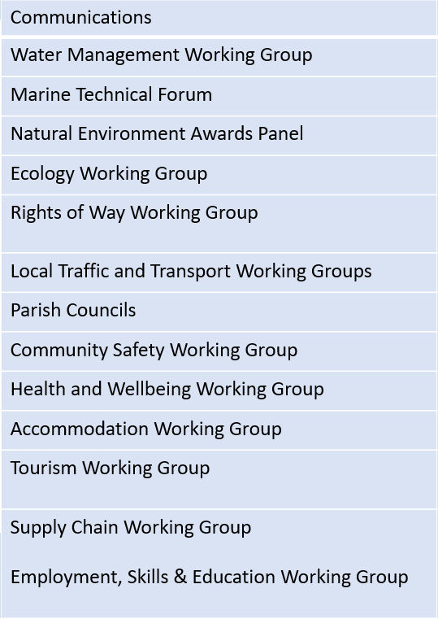
Working Groups
Planning Group
Community Forum (Annual)
Environment Review Group
Delivery Steering Group
Main Development Site
Forum
Transport Review Group
Northern Transport Forum
Social Review Group
Economic Review Group
Southern Transport Forum

Slide 7
Community Pledges
Support the Suffolk coast tourism sector to offset impacts from construction through the provision of a Tourism Fund.
Transport the majority of construction materials by rail and sea, significantly reducing the number of Sizewell C HGVs on local roads.
Provide a comprehensive 24/7 onsite occupational health service for workers, a healthcare contribution and a Public Services Contingency Fund.
Minimize disruption to local communities during the construction of Sizewell C
Respect the Suffolk Heritage Coast and minimise impact on RSPB Minsmere, National Trust Dunwich Heath and Leiston Abbey.
Invest in local employment, education and skills. This includes an aim to enable 1,500 apprenticeships.
Require all workers to sign a Worker Code of Conduct and enforce it – as we have done successfully at Hinkley Point C.
Return the temporary construction area to a standard befitting the Area of Outstanding Natural Beauty (AONB) following construction.
Support the growth of the local economy. This includes measures to support local firms in gaining work on the project.
Enhance the economic, social and environmental wellbeing of local communities through the provision of a Community Fund.
Remove the accommodation campus and caravan site, the park and ride sites, the rail extension of the Saxmundham to Leiston branch line and freight management facility following construction and restore the land.
The Sizewell C Project will not impact on the supply of water to local residents by a single drop. We have a sustainable strategy to provide potable water throughout construction and the operation of the new power station.’

Slide 8
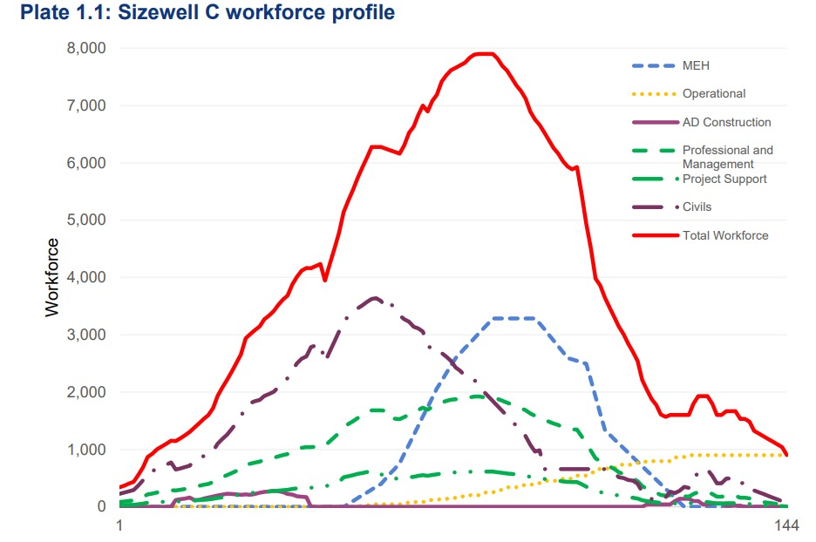
Accommodation and Housing
2400 bed accommodation campus (including a shop) , with a further 400 pitch caravan park available as temporary accommodation
A third of the workforce will come from the local area with an aim to exceed this figure.
Further accommodation will be via tourist accommodation, private rented sector, purchased accommodation for relocation.
Accommodation Strategy (planninginspectorate.gov.uk)

Slide 9

Occupational Health Services
24/7 on-site occupational health service
Services will include a drop-in nurse-led treatment service, commonly-prescribed medication, GPs
Available to home-based workers as well as those living in Sizewell C-provided accommodation
Drug and alcohol testing
Further services incorporated as workforce grows
Additional funding to support local health services

Slide 10
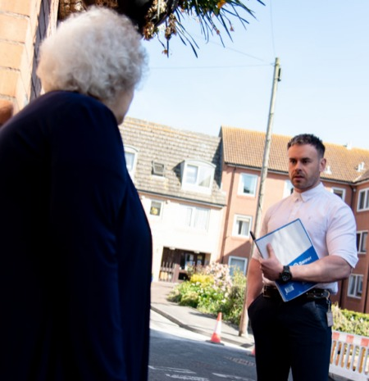
Emergency Services and Community Support
Funding for emergency services in East Suffolk. Locality Sgt in post and working closely with the Community Relations Team
Police reserve funding
Community Safety Officer will work with local stakeholders to address concerns
Resources devoted to council-led initiatives that reduce crime and anti-social behaviour
Pressures on education and social care addressed through a resilience fund
Community Safety Management Plan - infrastructure.planninginspectorate.gov.uk

Slide 11
Workforce Conduct
The conduct of the SZC workforce in the community is of the highest importance. It is for that reason that everyone involved with the SZC Project is expected to:
Be responsible for your safety and the safety of others by complying with all applicable laws, rules, and regulations;
Be ambassadors for the project through your behaviour and actions on site and in the community, including in the use of social media
Refrain from anti-social behaviour, discriminatory behaviour or harassment on and off site
Ensure that they are not intoxicated by alcohol or under the influence or illegal drugs
Respect colleagues and endeavour to maintain harmonious workplace relations at all times
Ensure that rented accommodation is maintained in a tidy state with the proper disposal of rubbish
Ensure that personal noise levels are appropriate to the time of day and location
Ensure no damage of any kind is caused to property on the off site
Respect speed limits and be aware of other road users, agricultural vehicles and livestock
‘By attending and completing the SZC Site Induction and receiving access to SZC site you are confirming your commitment to the expectations described above’’.

Slide 12
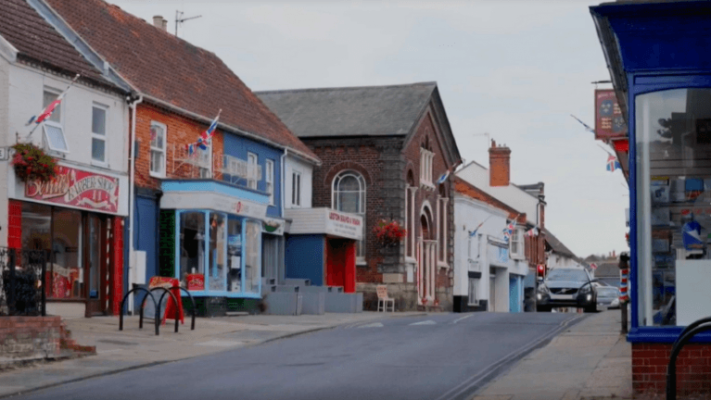
Community Fund
£23mn for projects that promote the economic, social or environmental wellbeing of East Suffolk to filter through the lifetime of the project
Administered by Suffolk Community Foundation; public representatives on the funding panel
Further support from Community Action Suffolk and East Suffolk Community Partnerships
Focused where impacts are greatest
Small grants, Open grants, Strategic grants covering different purposes

Slide 13

Economy and Tourism
Tourism fund £12,000,006 for purpose of mitigating potential impacts on tourism.
Tourism fund will oversee delivery of tourism plans, projects and programmes
Supporting ESC employ a Tourism Programme Manager and a Tourism Working Group

Slide 14
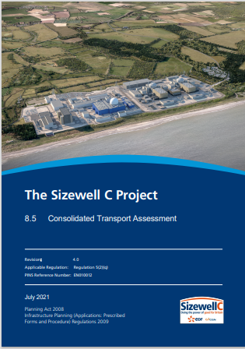
Transport
Workers will be encouraged to use a designated route to their allocated parking facility
HGVs will follow a designated route – enforced by an onboard tracking system
Local Traffic and Transport Working Groups (inc B1122 and B1125)
Transport Review Group
Northern and Southern Transport Forums
Transport Co-Ordinator
Monitoring
Find these documents at:
The Sizewell C Project | National Infrastructure Planning (planninginspectorate.gov.uk)
Construction Worker Travel Plan
Construction Traffic Management Plan
Traffic Incident Management Plan
Consolidated Transport Assessment

Slide 15
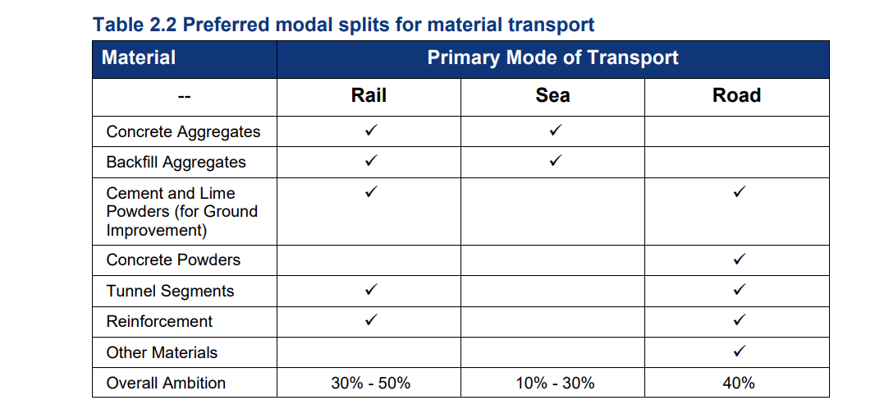
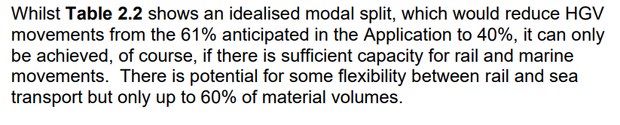
Material Transportation
Freight_Management_Strategy (planninginspectorate.gov.uk

Slide 16
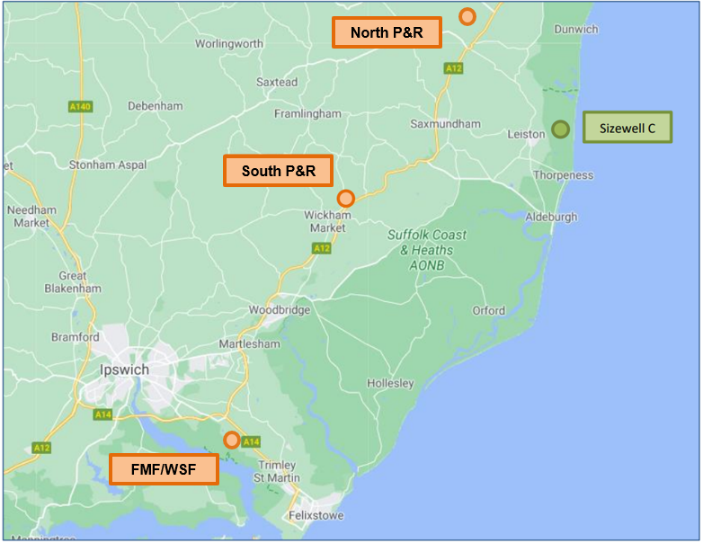
Highway Works
Associated Development
Two Village Bypass – Farnham and Stratford St Andrew
Sizewell Link Road
Yoxford roundabout
Green Rail Route
Southern Park and Ride
Northern Park and Ride
Freight Management Facility
A12/A144, A12/B1119 and A1094/B1069 junctions

Slide 17
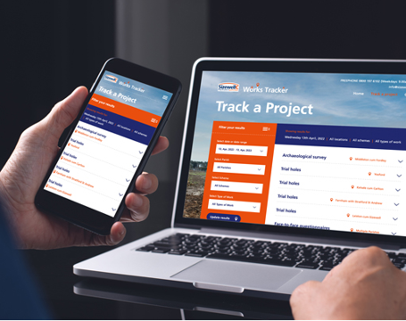
Project updates
New online works tracker to keep local communities informed about surveys and other preparatory works
Contact our Leiston office – info@sizewellc.co.uk or 0800 197 6102

Slide 18
Thank you

Slide 19
SZC Emergency Coordinator
Leads the emergency response and required tactical intervention to an incident. Has knowledge, experience, and an ability to coordinate specific resources required for response.
Key Responsibilities
• Lead and coordinate the overall SZC emergency response.
• Support the Sizewell B response to a declared incident, Site Emergency, an Off-Site Nuclear Emergency, or those Sizewell B events having a SZC site wide impact.
• Provides SME advice to the incident controller in respect of construction related incidents.
• Undertakes a risk assessed approach to any tactical option available to respond to a construction site incident and provides advice to the Incident Controller and Sizewell B Emergency Controller in respect of the most appropriate response to be implemented.
• Tasks the SZC construction contractors to achieve response objectives.
• Achieves, maintains, and communicates situational awareness impacting construction during incident response.
• Assesses, communicates and, if agreed, arranges for the implementation of the preferred and selected tactical option(s) for incident resolution.
• Manages and co-ordinates any required construction assets and equipment to control an incident.
• From a construction perspective, considers the impact of any emergency as it may affect the project programme and integrated work schedule.

Slide 20
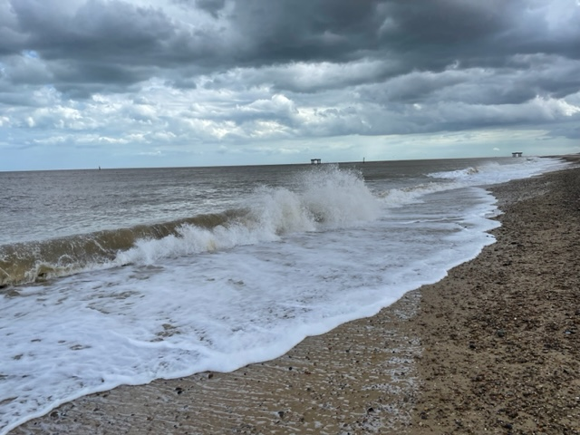
Marine and Coastal
Sizewell is located within a stable part of the Suffolk coastline between two hard points and the large offshore Sizewell and Dunwich Banks
We have modelled potential future scenarios to fully assess the effect of the station on the coastal processes and vice versa using maximum plausible climate change predictions from Met office data.
The power station and access road will withstand a 1 in 10,000 year storm event including sea level rise, tide and surge.
The sea defence will protect the site from coastal flooding. It incorporates a soft dune defence that is sympathetic with the existing landscape and mirrors existing coastal processes.
The sea defence can be raised during the lifetime of Sizewell C if needed – the same is true of the access road

